Slide 1

The Security Guide to the Internet
Author: Bc. David Nápravník
Supervisor: doc. Mgr. Cyril Brom, Ph.D.
Let’s play and learn
2025
Image from deep.ai

Slide 2
Motivation
95%
26%
The growing threat landscape for children online
Need for engaging cybersecurity education
kids are using mobile phone with internet access daily in age of 12 in Czech Republic
of children (11-15 y.o.) report
encountering phishing attack
Source: eu_kids_online_report
Source: Overconfident and over exposed
Notes:
I worked for cyber security team for 6 months.
And I saw how easily users gave away their login data.
I wanted to lower this number by educating users as young as possible.

Slide 3
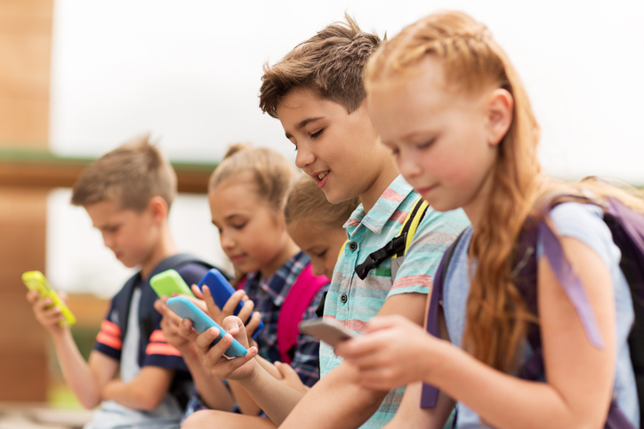
Target Audience
Middle school students.
Single player at home, or at school.
Czech or English speaking.
Years 11-15
Kids doesn’t have much security awareness and they are often exposed to cyber danger
Image from freedomfone.org
Notes:
That’s why I choose to educate students.
In moment they access the internet.

Slide 4

Security thread topics
Malware: Virus, Antivirus, Firewall, Software updates, Data backup
File extensions, Game with virus, Fake free stuff
Antivirus is a good thing, but it doesn't do everything
Privacy: Phishing, Identity theft, Social engineering
Digital footprint, Privacy protection, Bad practices
Cookies & GDPR
Phone: App Permissions
Bluetooth and wi-fi safe usage
Access: Strong passwords, Password managers, Two-factor Authentication
AI: Information quality, private data sharing
Image from deep.ai
Notes:
I focused on users hazards only, and not the system holes.
Searched for most common and most painful threads.

Slide 5

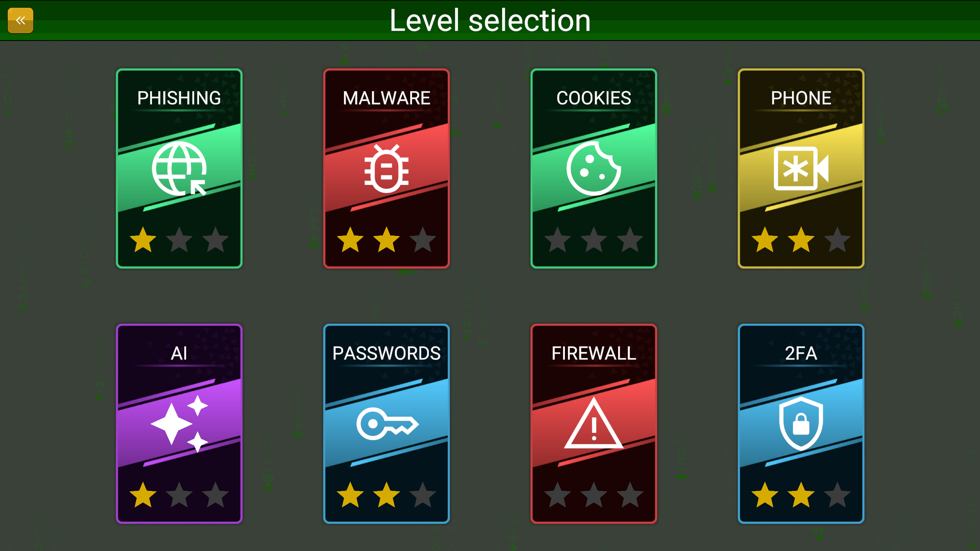
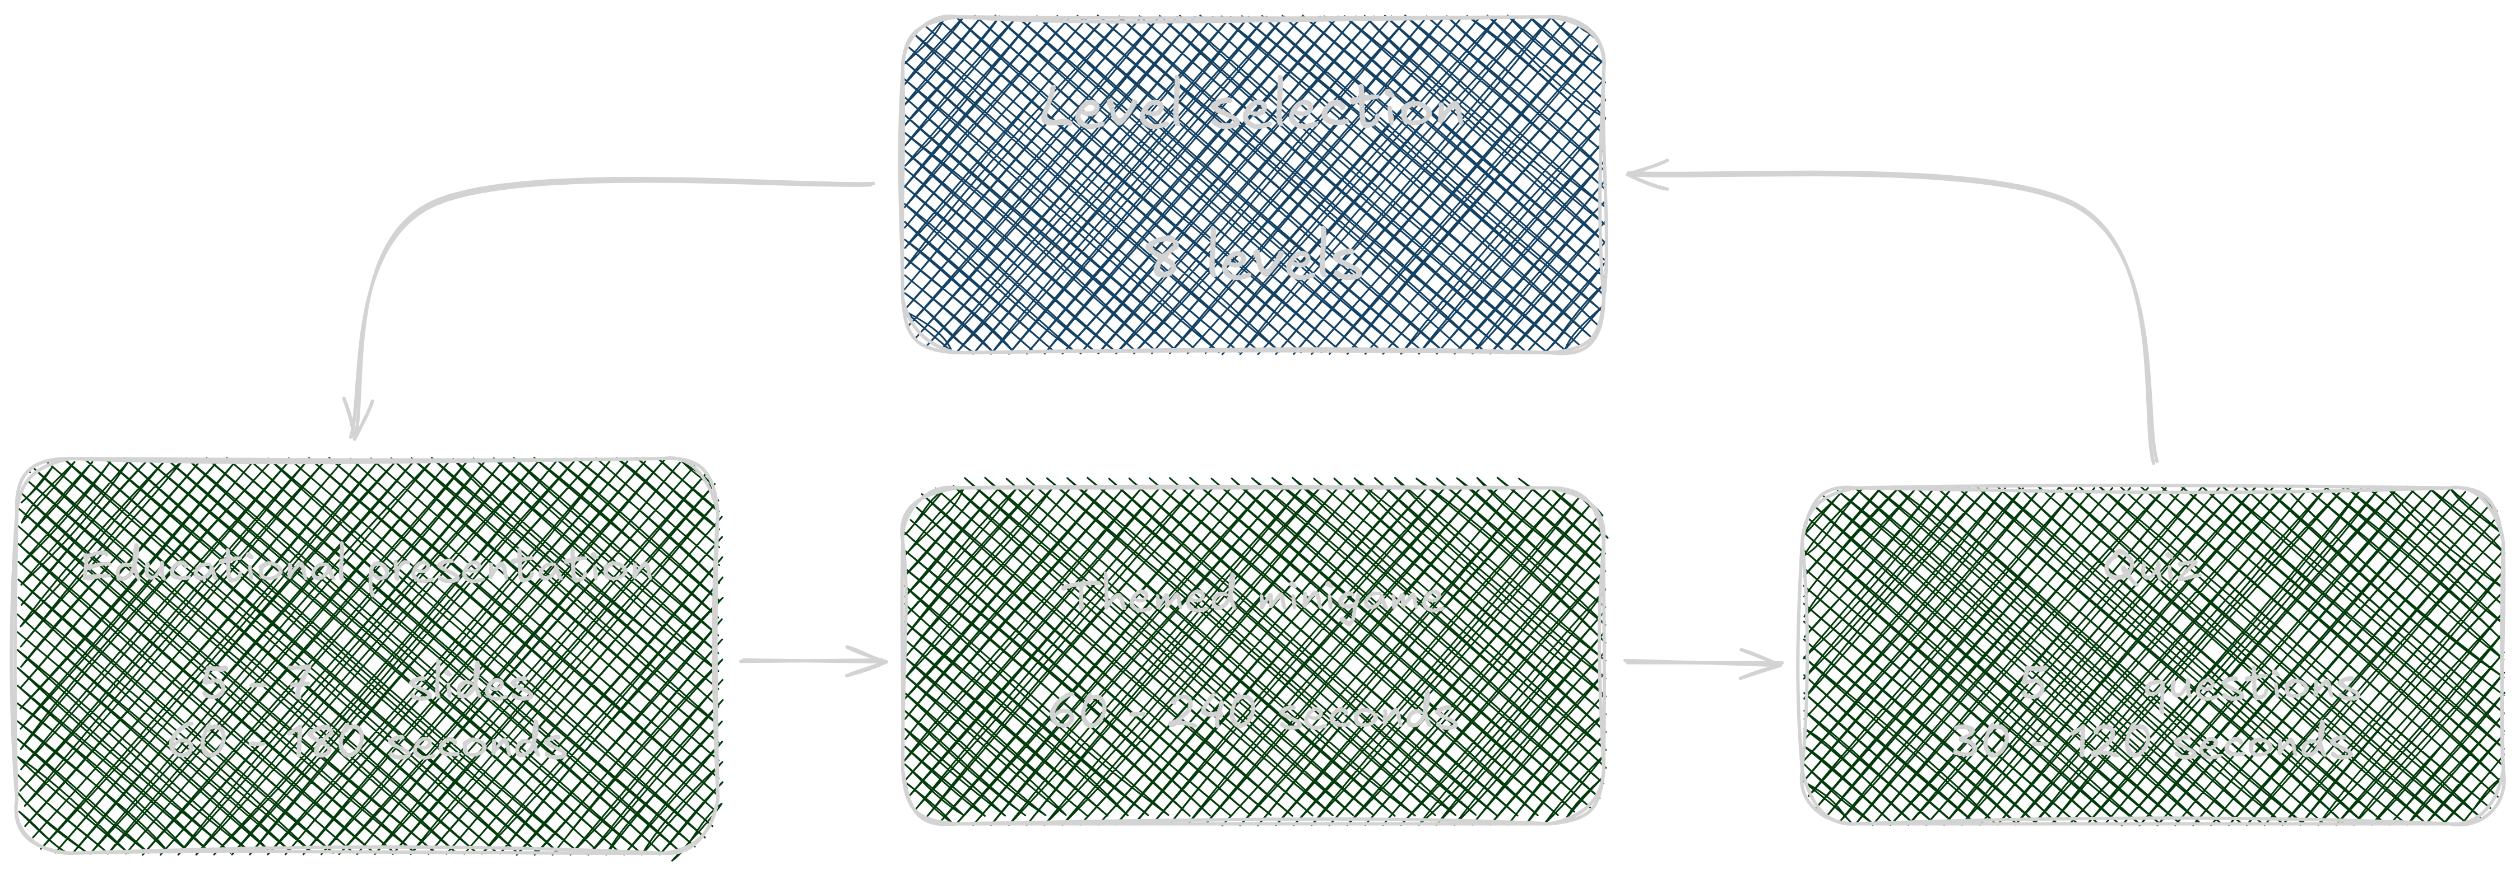
8 levels
Each for some group of security topic
Each have presentation, minigame and quiz
Multiple devices support
Android, Computer (without installation)
Compliances
PEGI 7 (no inappropriate content)
Game Concept
Images from the thesis
Notes:
Game loop: each level has presentation, minigame and quiz.

Slide 6
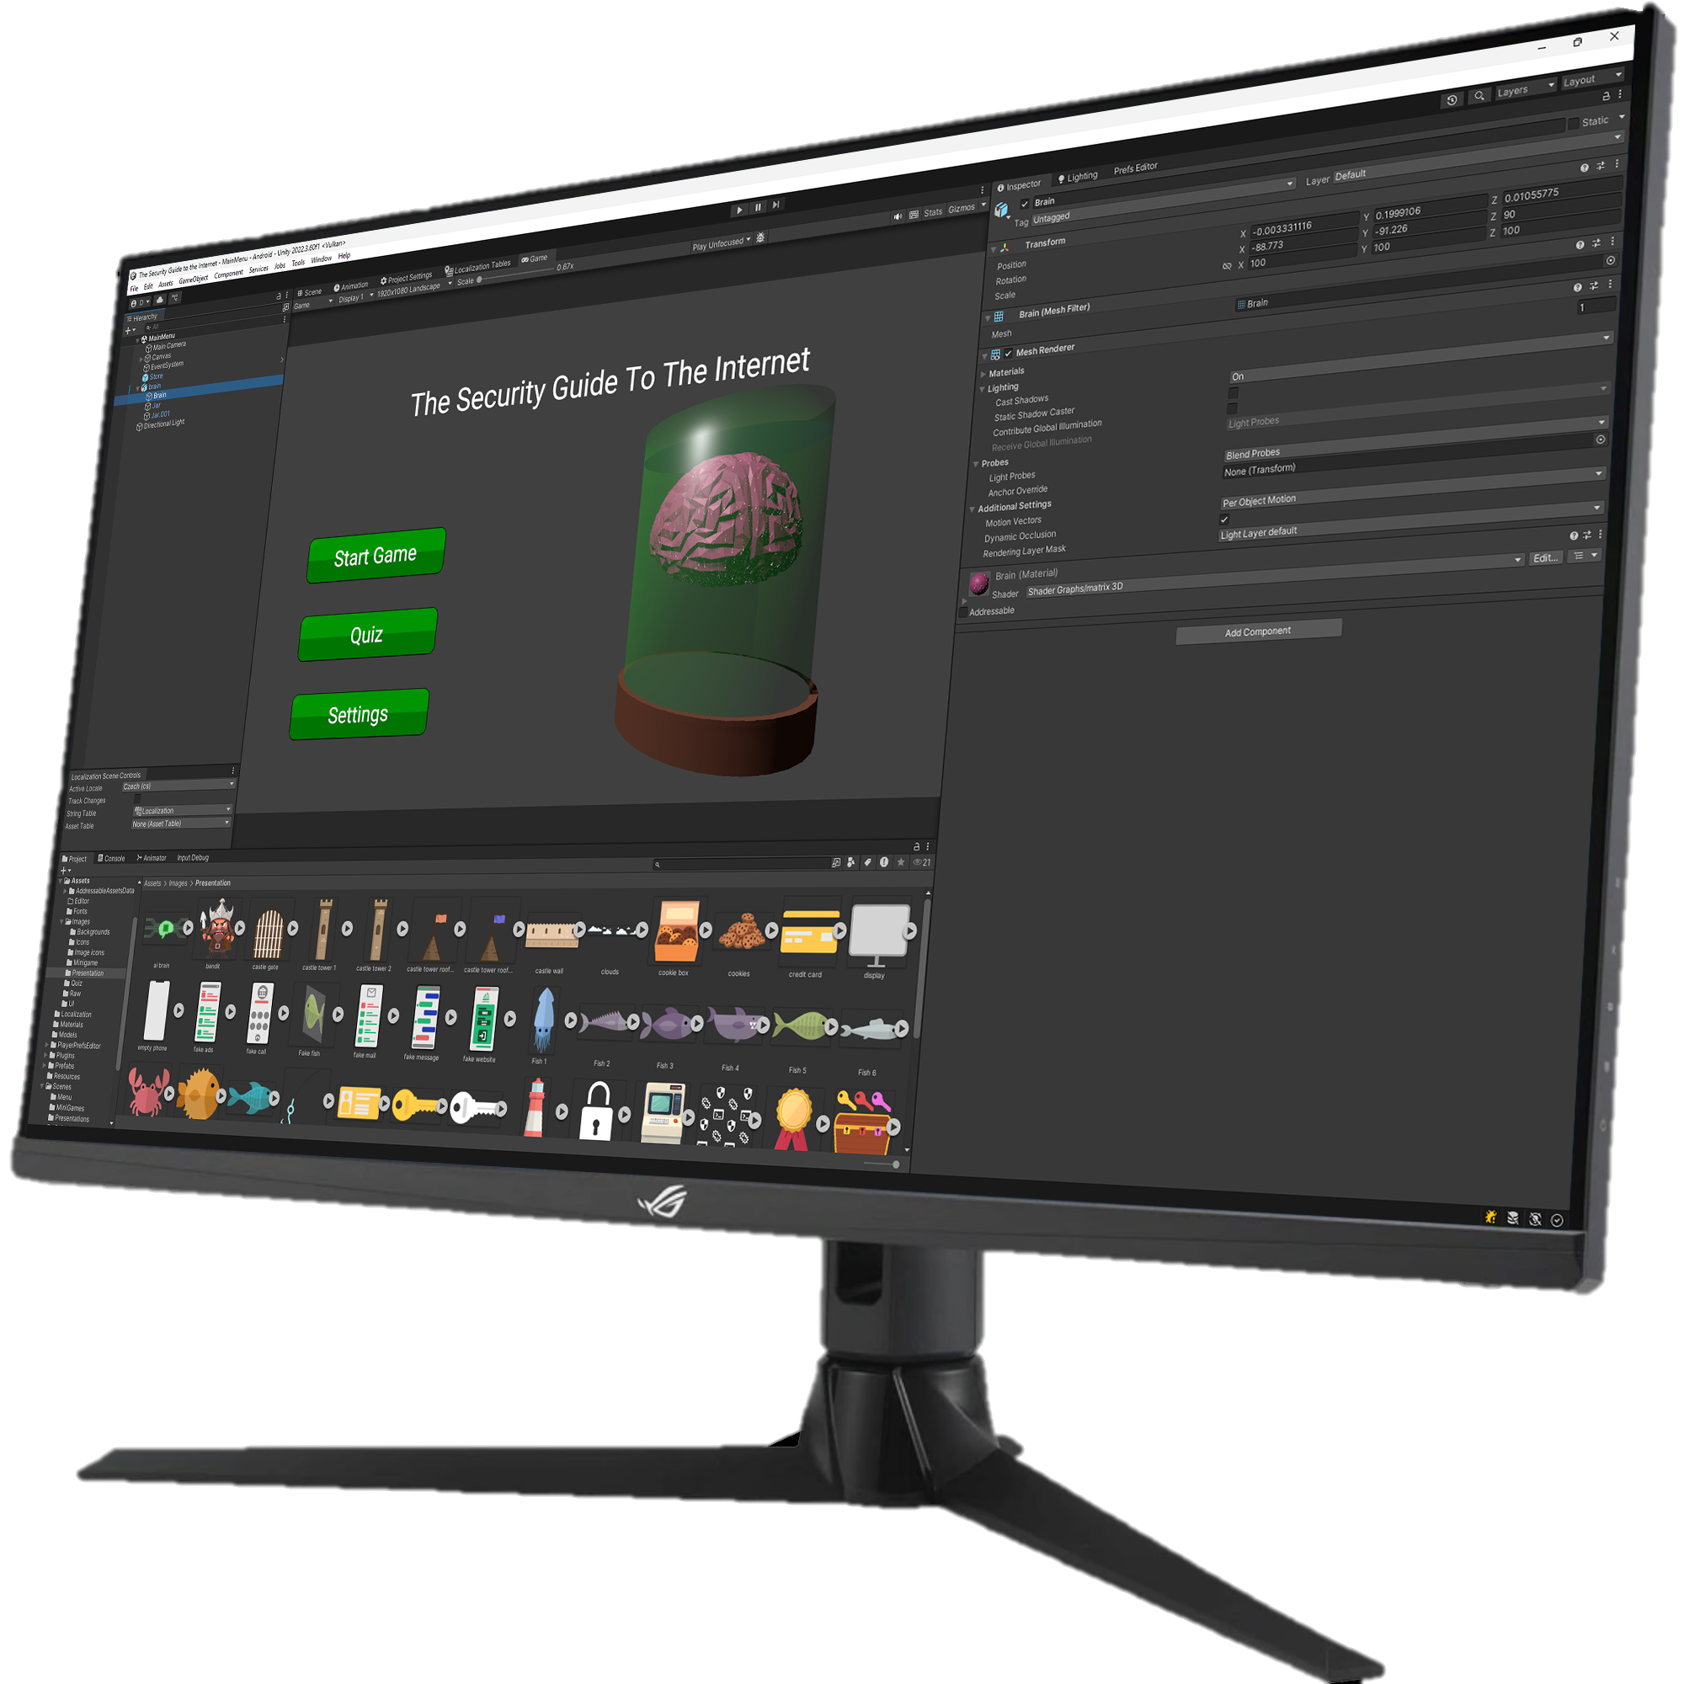


Implementation Details
Game engine
Localization
Text rendering optimizations
Bundle size optimizations
Level-specific mechanic
 | Godot | Unity | Unreal engine
Web build
Low-end devices
Advanced profiling tools
Image of this thesis Unity project
Notes:
Checked large and small game engines (not only these 3).
Unity in the end had everything needed and better tooling than Godot.

Slide 7


Implementation Details
Unity engine
Localization
Text rendering optimizations
Bundle size optimizations
Level-specific mechanic
1 bod
Získal jsi
2 body
5 bodů
Possible to easily add more languages
1 point
You got
2 points
Image from the thesis
Notes:
2 Languages
Easy to add another
Favorite part was Plural Rules

Slide 8



Implementation Details
Unity engine
Localization
Text rendering optimizations
Bundle size optimizations
Level-specific mechanic
Raster
SDFAA
WCAG 2.0
Contrast ≥ 4.5
Text size ≥ 24 px
AA
SDF32
Images from the thesis
Notes:
More than 50% is reading text
So text is optimized for best readability
By Web Content Accessibility Guidelines

Slide 9
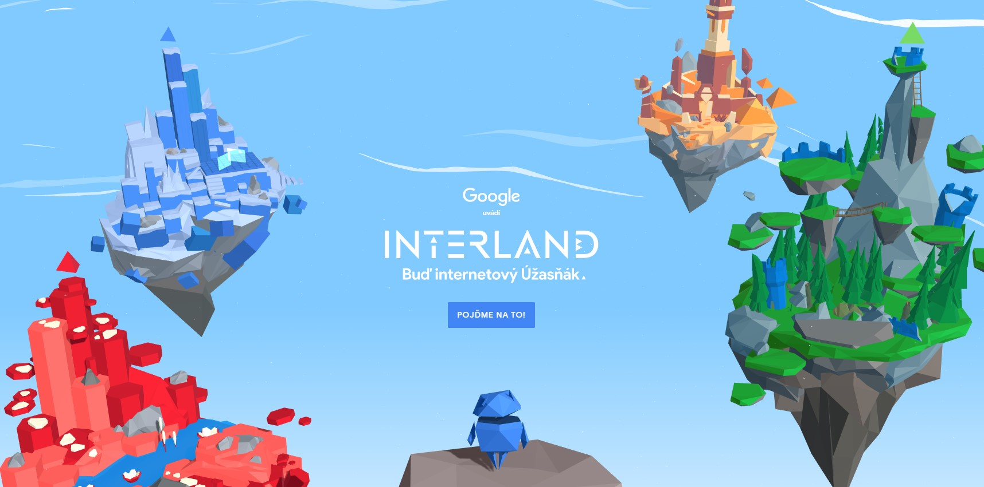

Implementation Details
Unity engine
Localization
Text rendering optimizations
Bundle size optimizations
Level-specific mechanic
Scripts 2%
Shaders 4%
Models 3%
Other 9%
Textures 82%
28.8 MB (4 levels)
Pre-rendered Font atlas 9%
11.2 MB (8 levels)
78.1 MB (2 levels)
Images from beinternetawesome.withgoogle.com & internethighway.e-bezpeci.cz
Notes:
Optimized for super minimalistic package
Of course compression, and code truncation, but most was about optimizing images
11MB = 1 second on average internet, better than 3 or 8 seconds

Slide 10
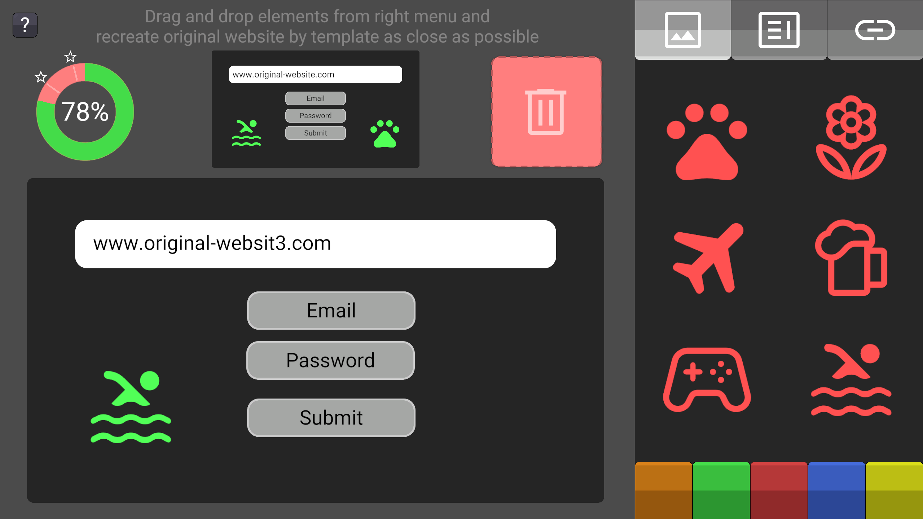
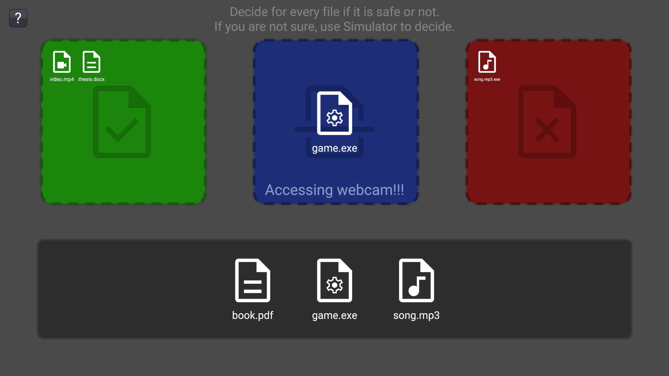
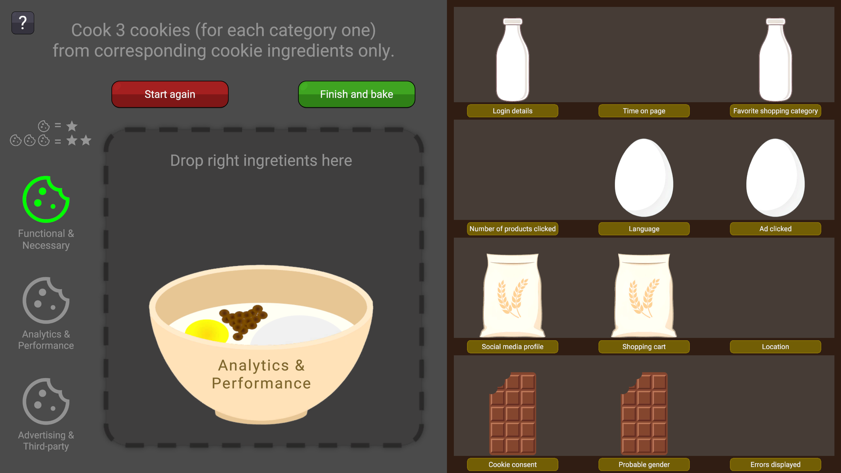
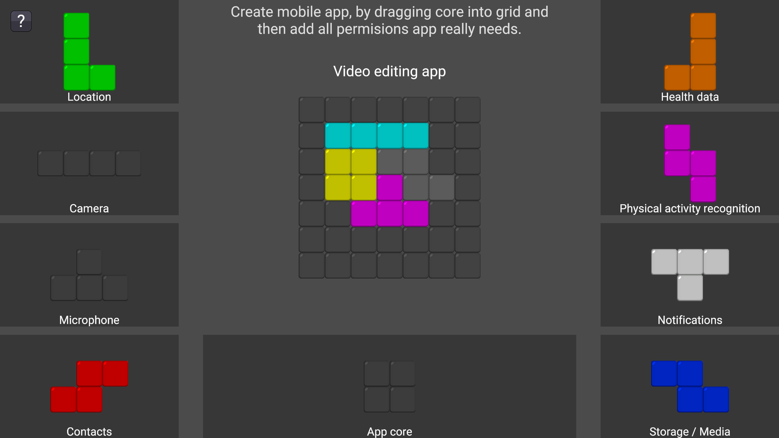
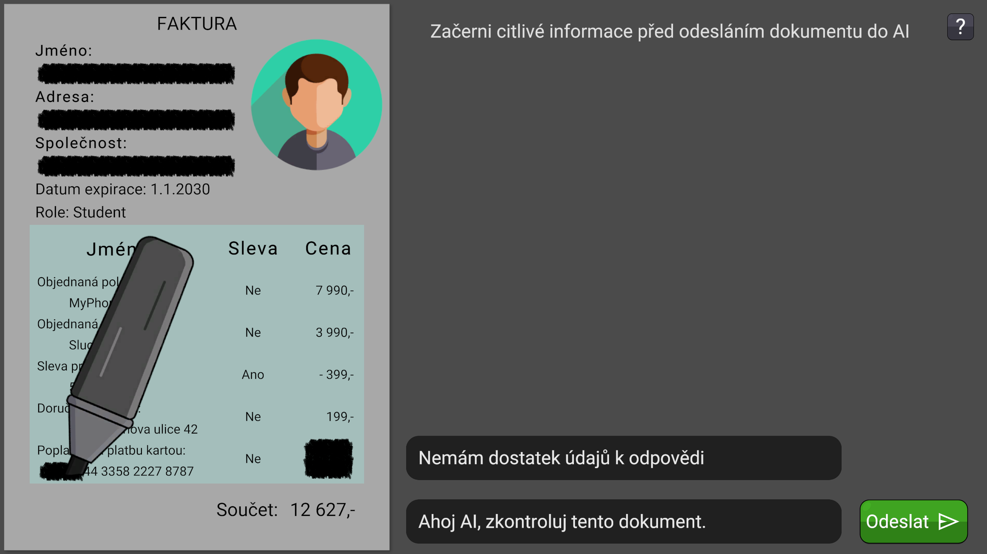
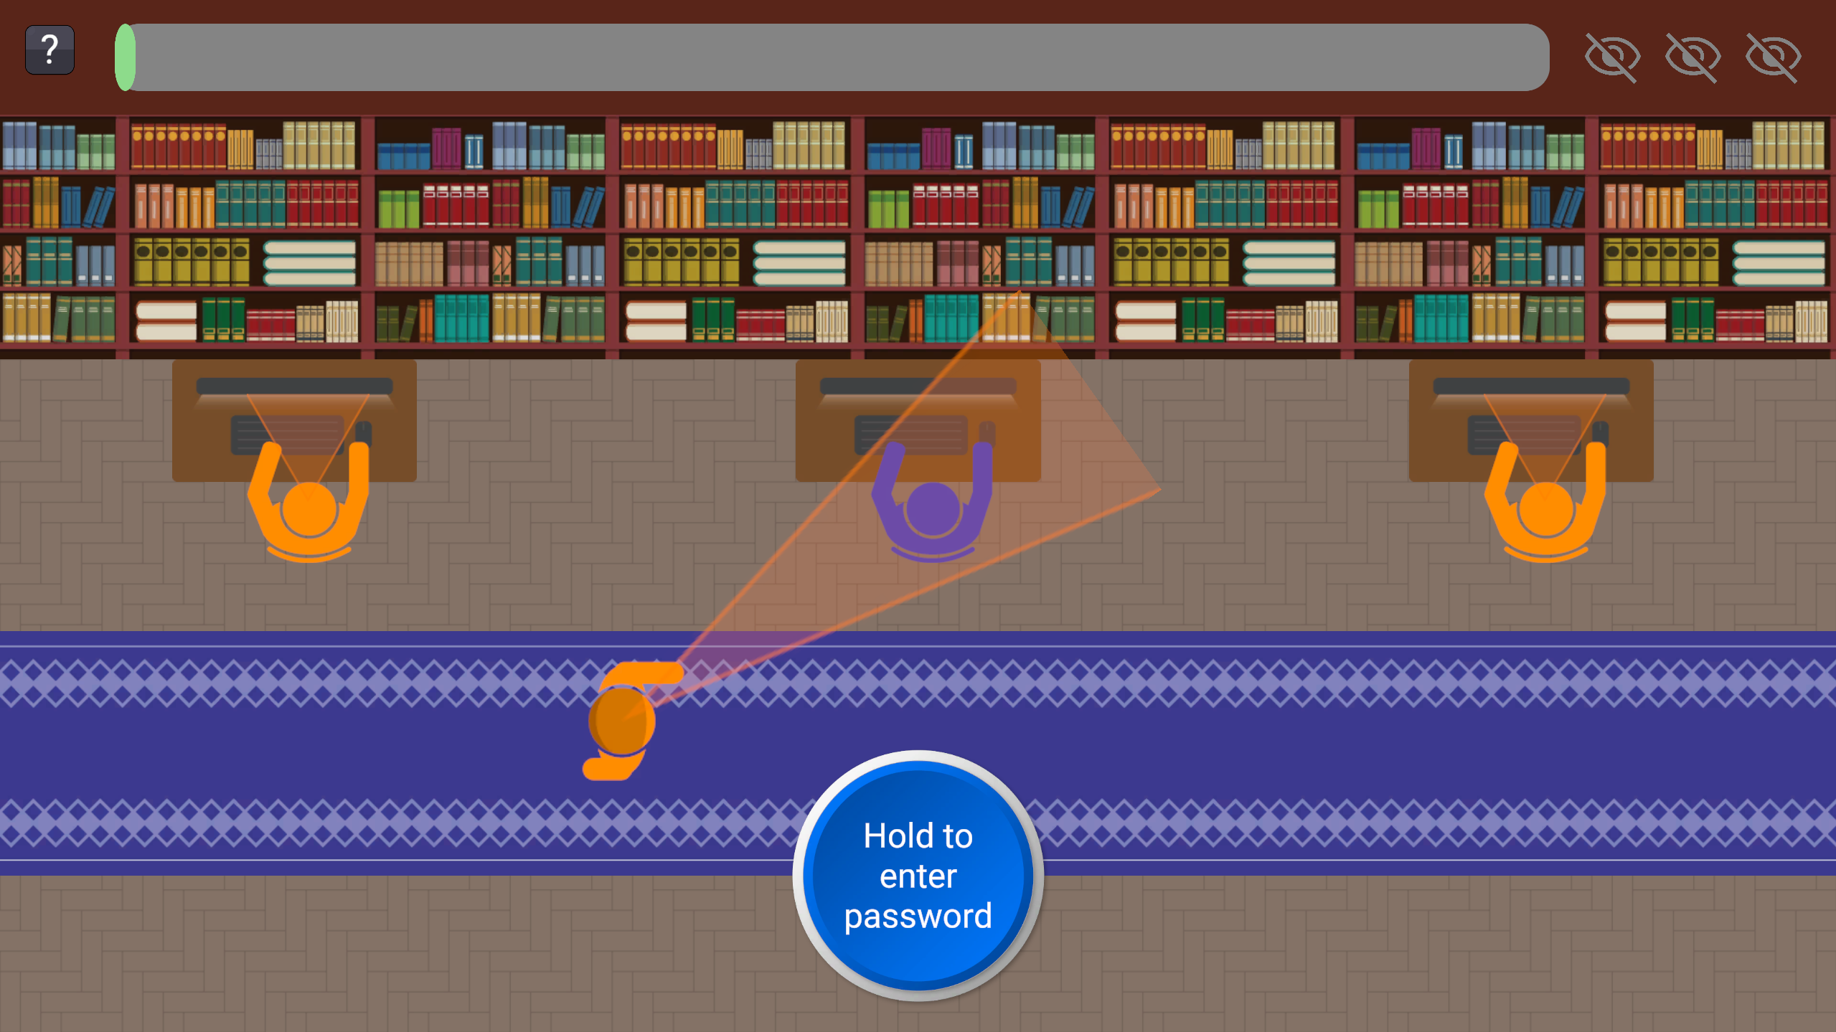

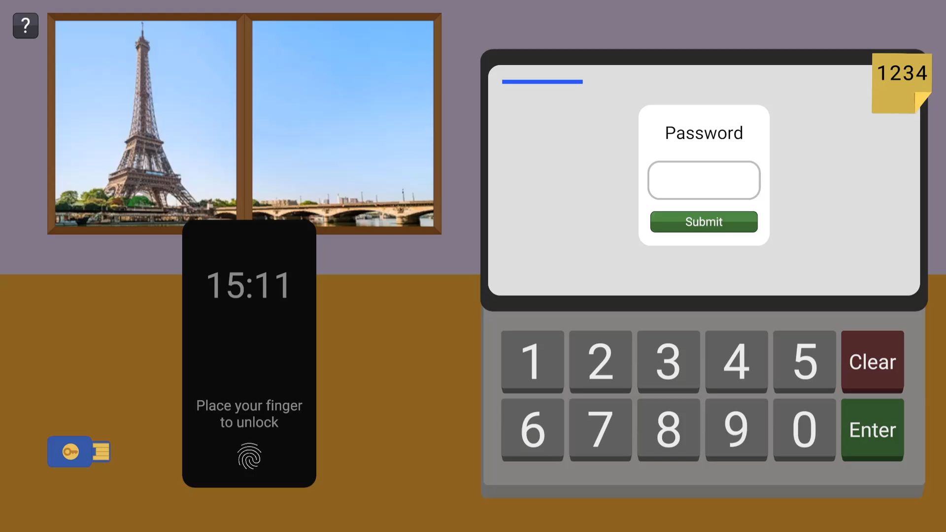
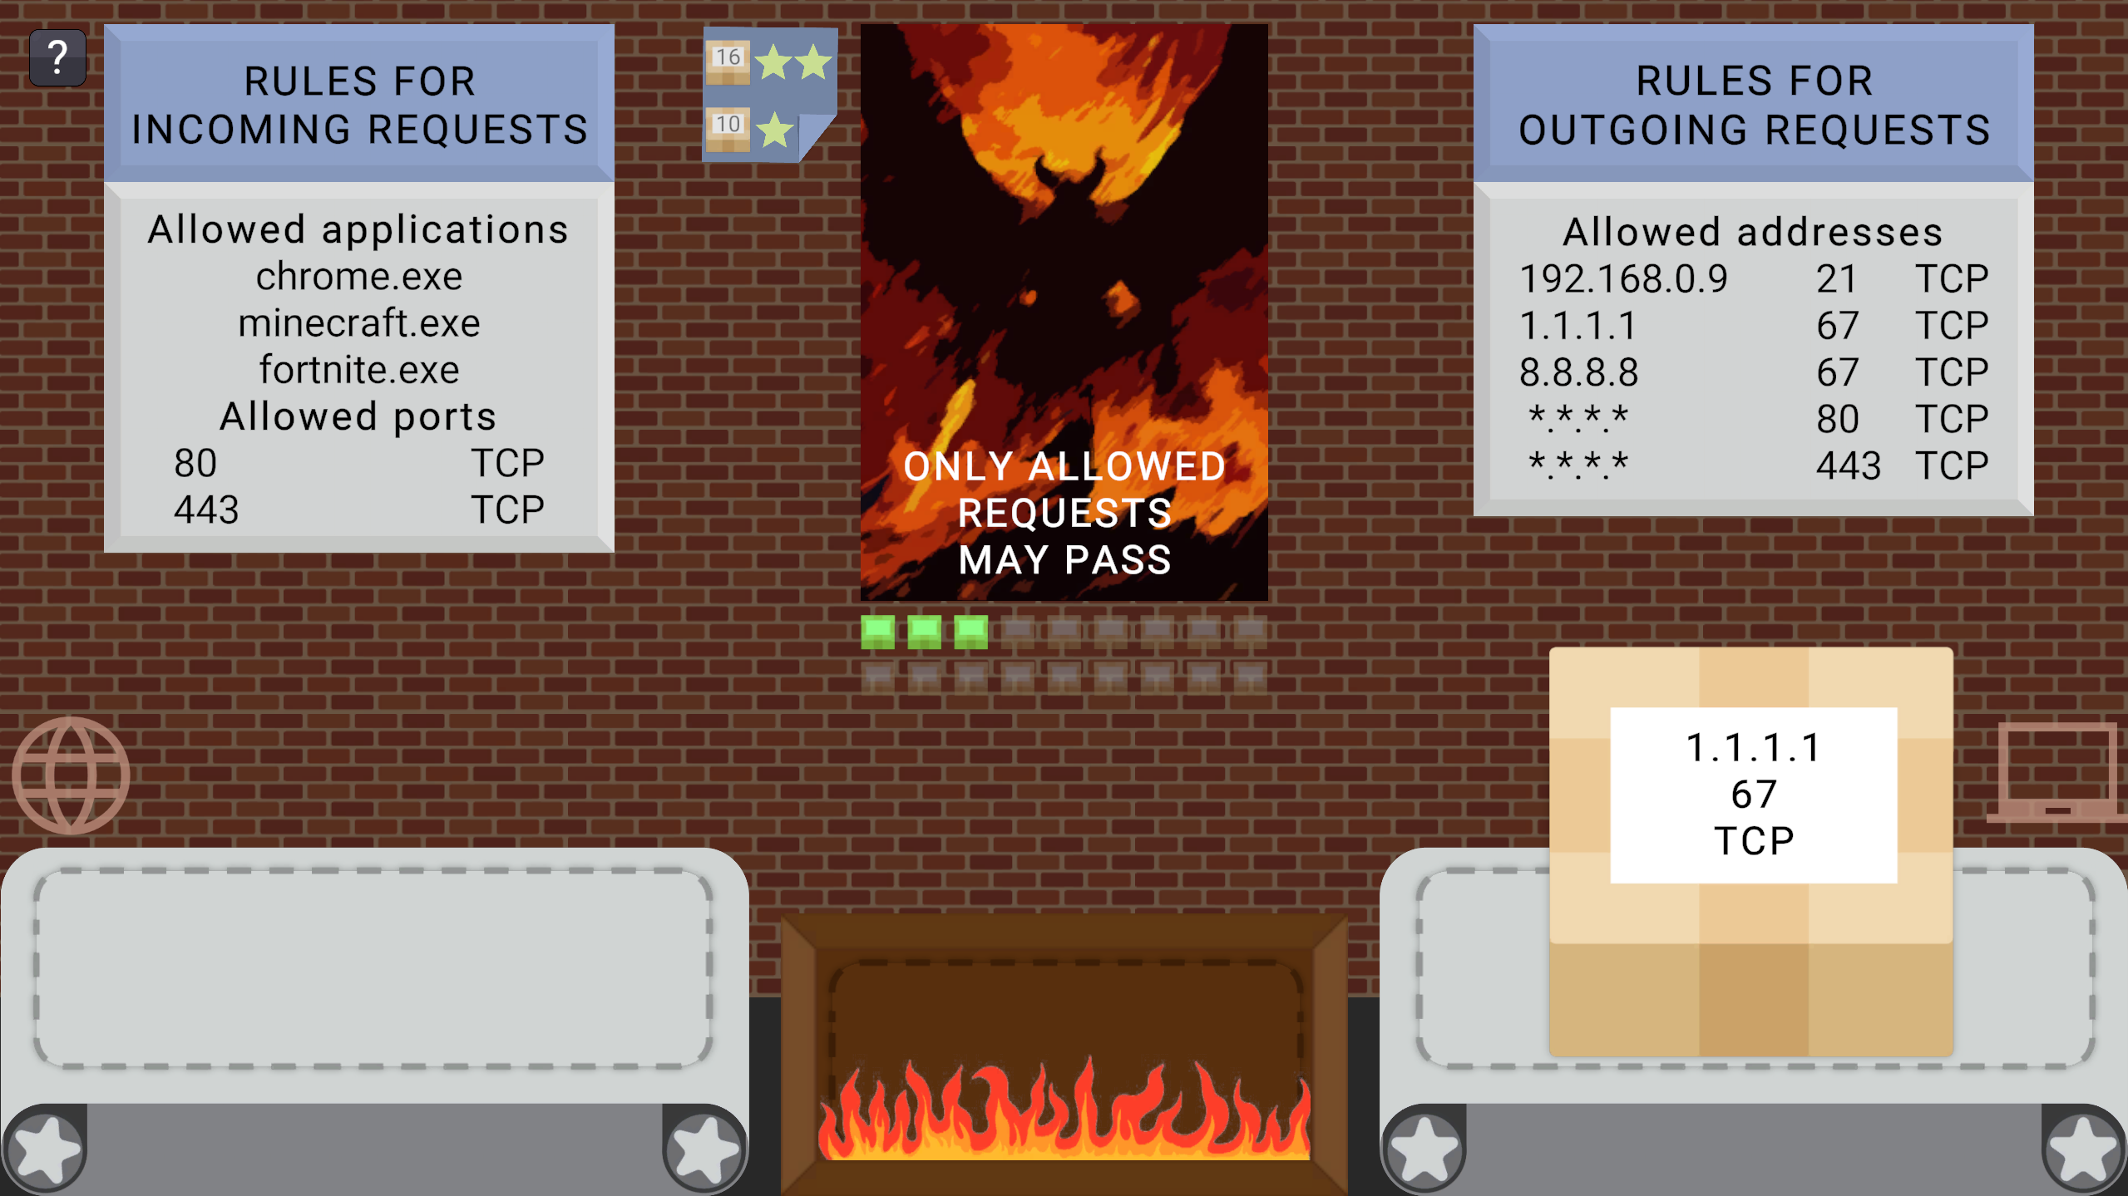
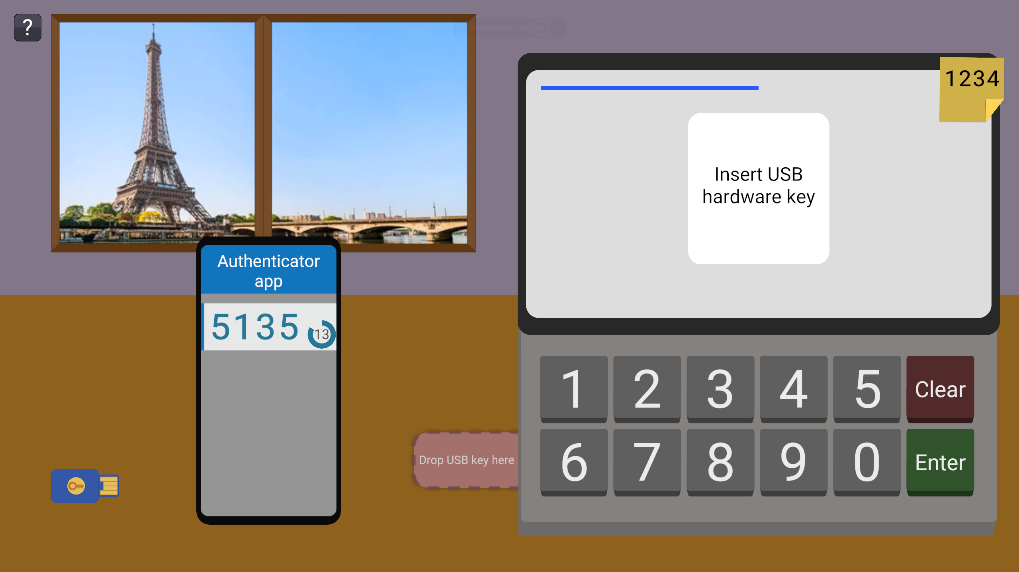
Implementation Details
Unity engine
Localization
Text rendering optimizations
Bundle size optimizations
Level-specific mechanic
Images from the thesis
Notes:
Every level has it’s own minigame with own mechanic and is in the theme of level topic.

Slide 11



Testing & Results
Testing methodology
Data collection
Findings
Individual testing
Class testing 1
28 kids
Class testing 2
25 kids
Testing for Google
24 people
Notes:
Firstly there was individual testing
That was used to prepare for class testing, to know the times and catch game and logging bugs.
Then we tested in grammar school twice, with 4 groups in total, that is more than 50 kids
We monitored the times, blockers and success in the quiz
After that there was one more testing needed to get into Play Store

Slide 12
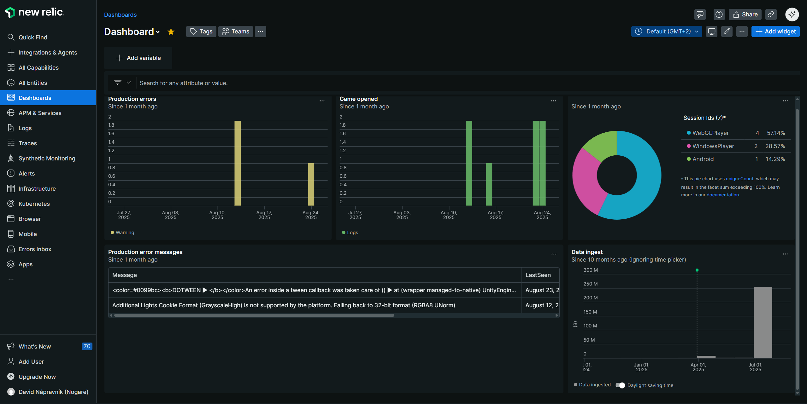
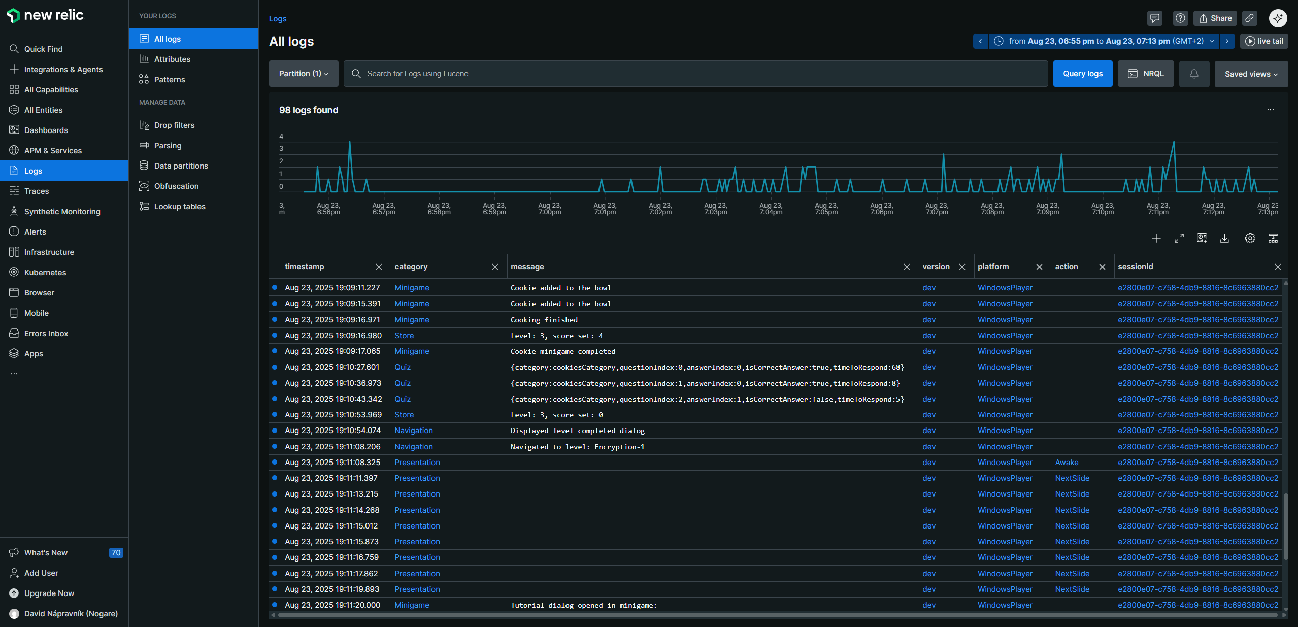
Testing & Results
Testing methodology
Data collection
Findings
18 000 Logs in total
Device
Navigation
What user clicked
How long something took
Images from newrelic.com
Notes:
During the testing logs were gathered, more than 18000 logs in total All stored for 30 days in new relic, app for logs
Classic logging of errors and warnings from unity
Plus Informative logs what users did and when they did it

Slide 13
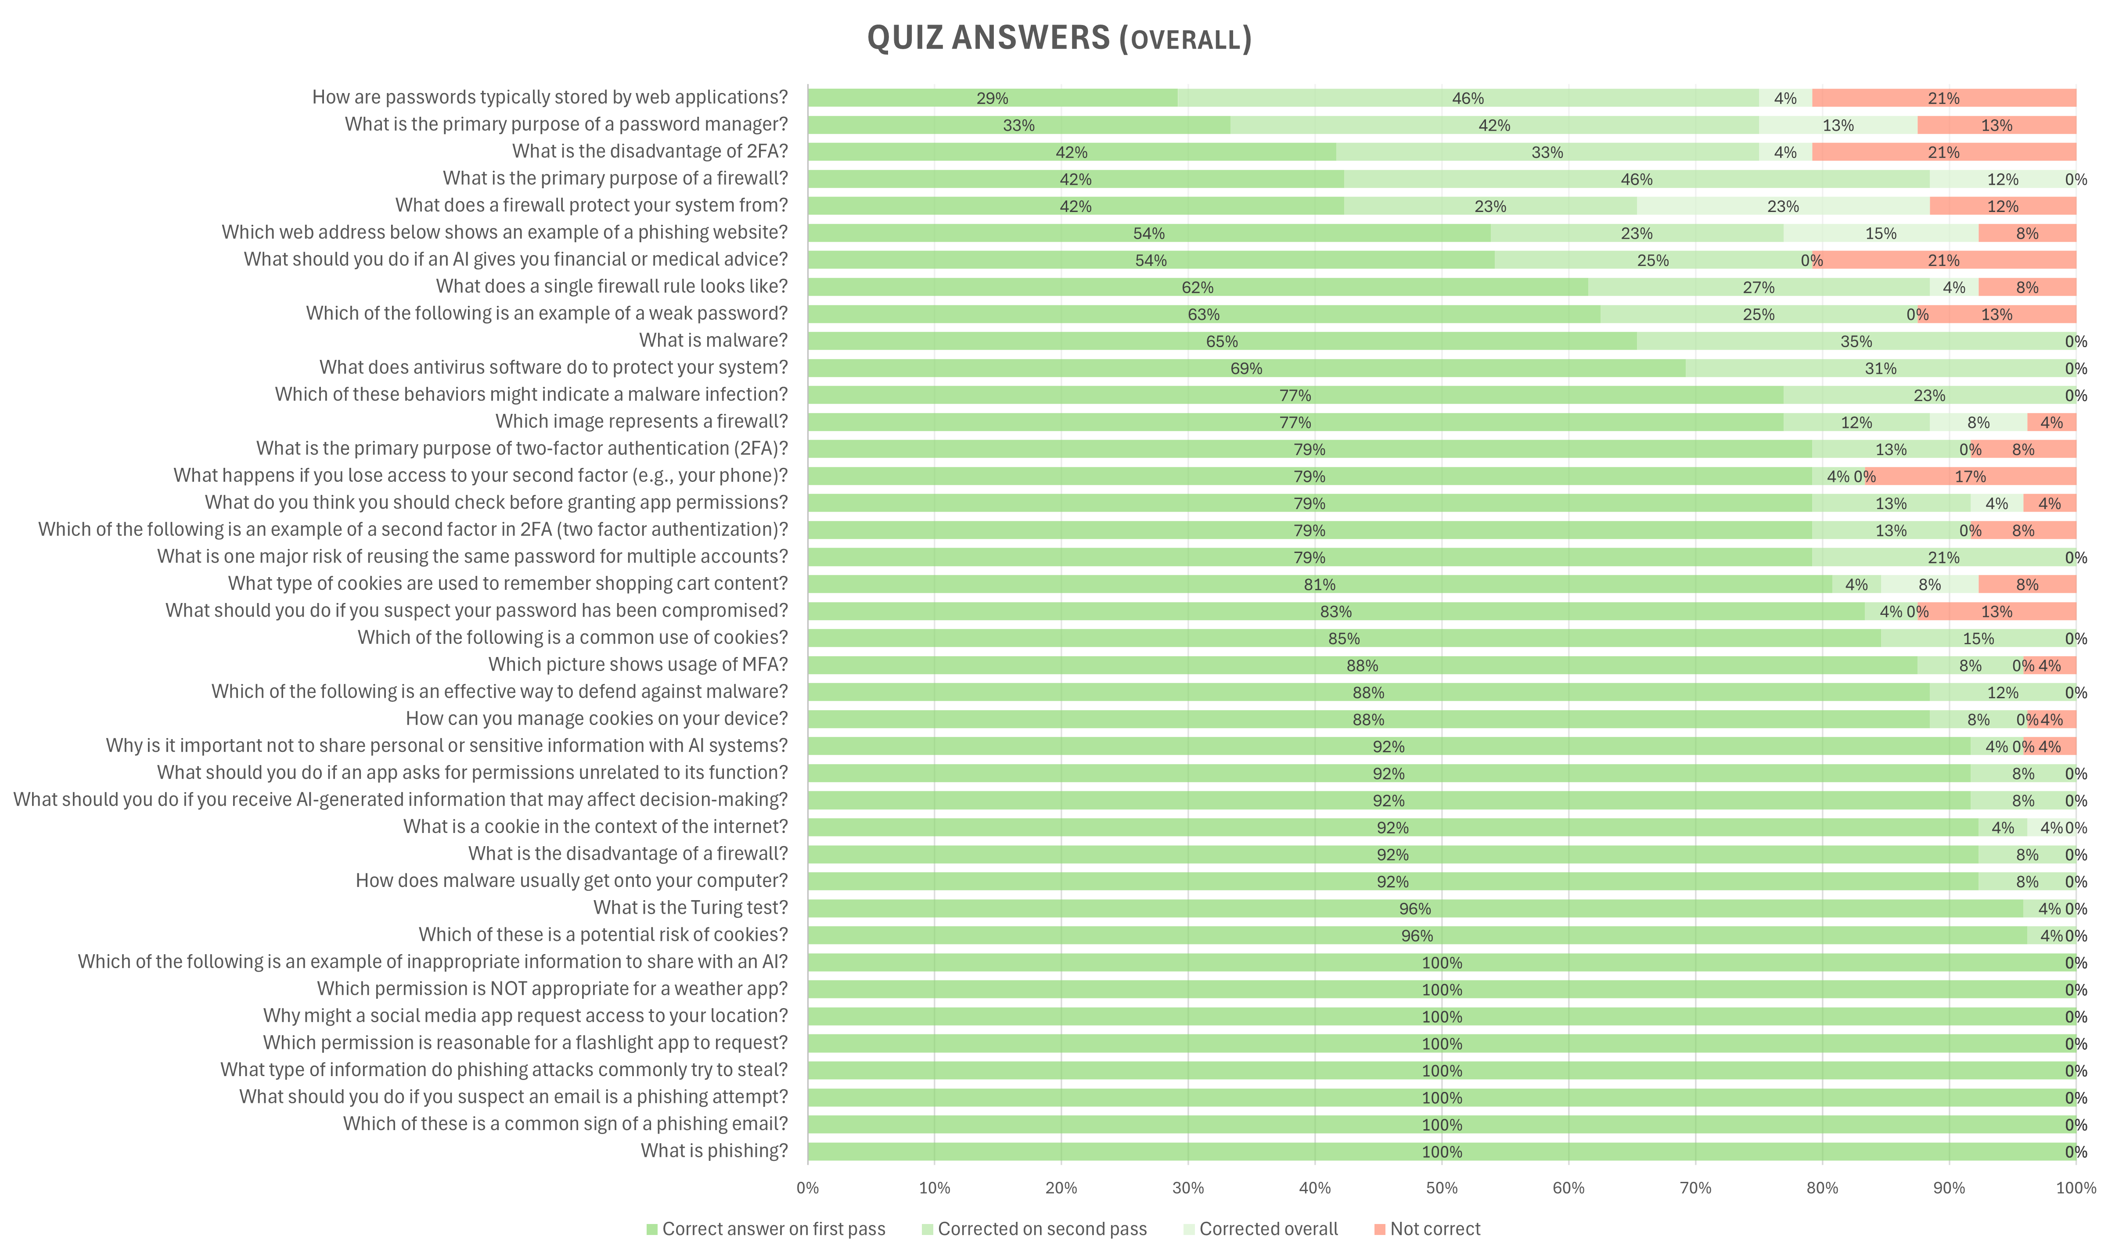

Testing & Results
Testing methodology
Data collection
Findings
Kids improved
from 79.1% to 95.3%
in the quiz.
5 Bugs
Discovered
(and fixed)
Data from the thesis
Notes:
From knowledge improvements kids reached 95% from 80% quiz correctness
They started high because they already had phishing topic in school and so they scored 100% on it
Timestamps showed which parts are hard to understand and needs to be clearer
Also 5 Bugs was discovered and fixed.
My favorite one was that somebody put backslash char into the name, which forced me to include many more symbols into character atlas.

Slide 14


Conclusion & Future Work
Research security topics
Create educational game
Test the game
Cover more topics
Port to iOS
Translate to Slovak
Notes:
The game was success, kids and teachers liked it.
But I would love to add more topics into it (e.g. protection of digital inventories)
Also publishing it to Apple store will enable some kids to use it easily.
And the easiest one would be to add at least Slovak translation so the app can be used there.

Slide 15

Thank You
Image from deep.ai
Slide Chef presentation template

